Slide 1

Prediction models using Linear Regression
Post Graduate Certification in Data Science (PGCDS)
Applied Econometrics – assignment #1
Prediction of Bollywood Movie Earnings
Sonali A. Nimkar
Powered by
November 2015
Version 0.2

Slide 2
Contents
Background
Solution Approach
The Solution
Appendix

Slide 3
background
Bollywood is the largest movie making entity on the planet, with an average annual turn over of about USD 3 billion / INR 1,200 crore.
This industry could significantly benefit from the use of sophisticated analytics methods towards lending a measure of scientific discipline to the art of film making.
This would necessitate gaining an understanding of factors that drive or impact the earning capability of movies.
We propose to use currently available historical data around the revenue financials, including marketing data and related characteristics of the movies, for statistical modeling of earnings’ behavior.
Earnings data and other statistics have been made available for a number of Bollywood movies released in calendar years 2014 and 2015.
Using this data, and the method of linear regression, models will be created and tested, with the final objective of using these for prediction of earnings revenue within acceptable tolerance of error and getting a general sense of the ROI on the various spending heads (cast, marketing).

Slide 4
Solution Approach
Data for 2014 were used as “Training data” for the models under creation.
Various combinations of parameters (explanatory variables) were identified and used in the lm function to generate different competing models; which were then filtered on the basis of the R-squared value.
An exhaustive number of models were generated and inspected for goodness of fit using R-squared, by identifying combinations of variables from the shortlisted set - (details in the Appendix).
To reduce complexity and yet, retain relevance – out of the given set of forty-two explanatory variables, eighteen were shortlisted and used for modeling.
The model obtained using the 2014 data and selected for use, was then tested for validity of prediction using the 2015 data.
Note: the 2015 data, being sparse, the model will require further testing to ensure accuracy of prediction.

Slide 5
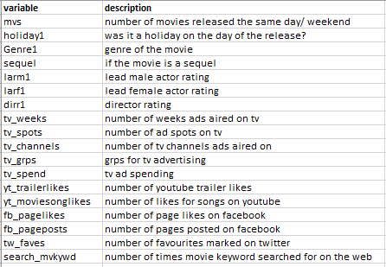
Solution approach
The accompanying table lists the eighteen explanatory variables used.
The data themselves are specified in the embedded excel files on this page.

Slide 6
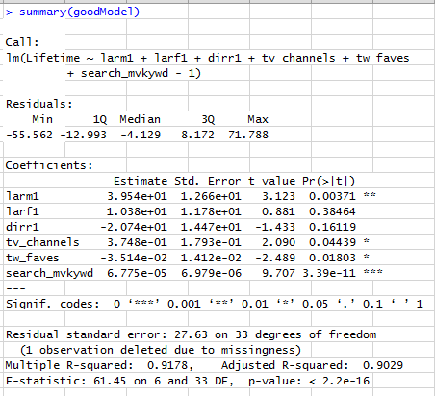
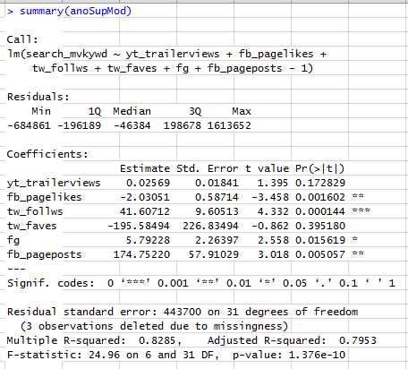
The Solution

Slide 7
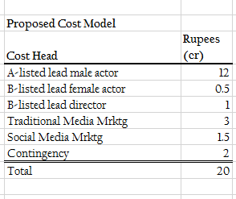
The Solution
Given the significance of the lead male actor – an A-rated star will very likely have a great impact on the earnings figures.
The next focal point would be the marketing spend on traditional and social media advertising.
Once again, given the significance of social media elements as reflected in the model, and the (increasing) penetration of the social network - a greater than typical allocation to digital marketing is proposed.

Slide 8
Going forward …
Test the veracity of the identified model(s) using data for 2015.
Using the validated model for prediction and gauging ROI impact.

Slide 9
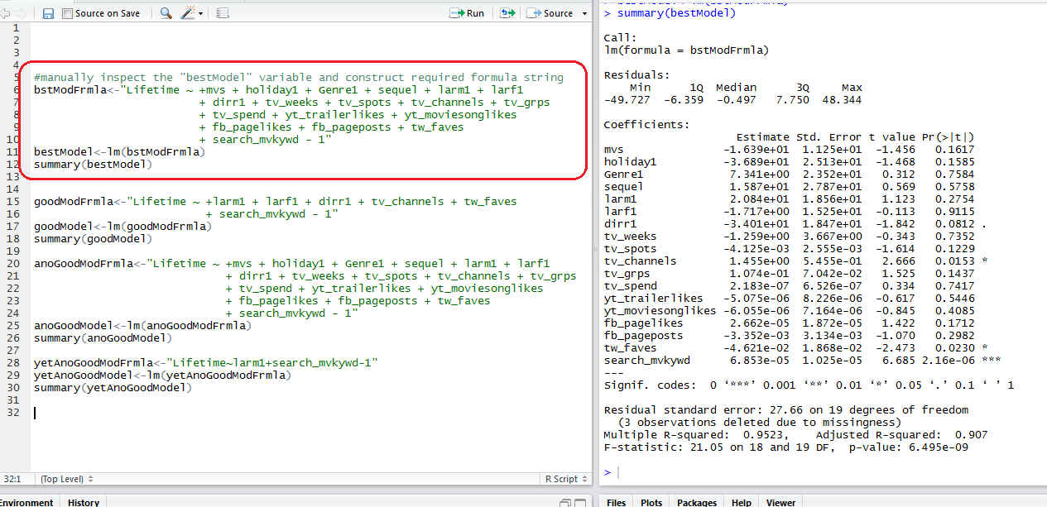
Appendix

Slide 10
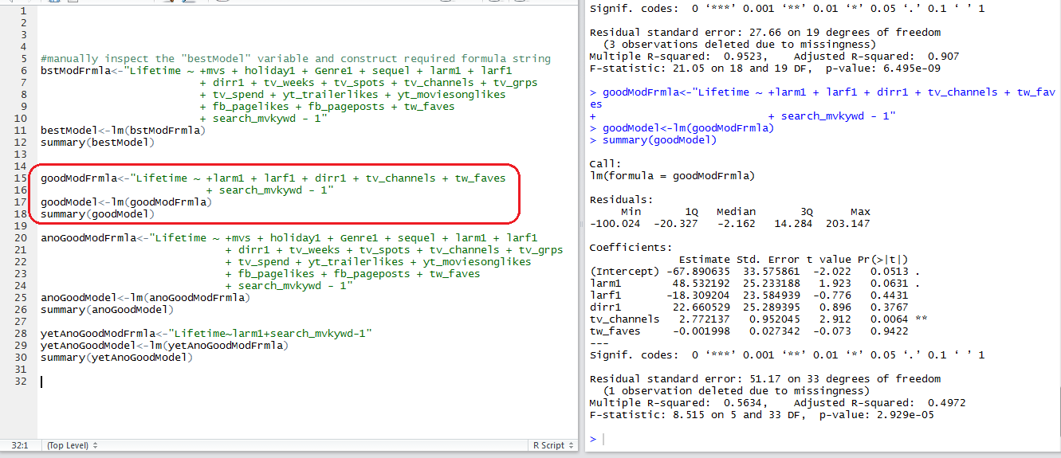
Appendix

Slide 11
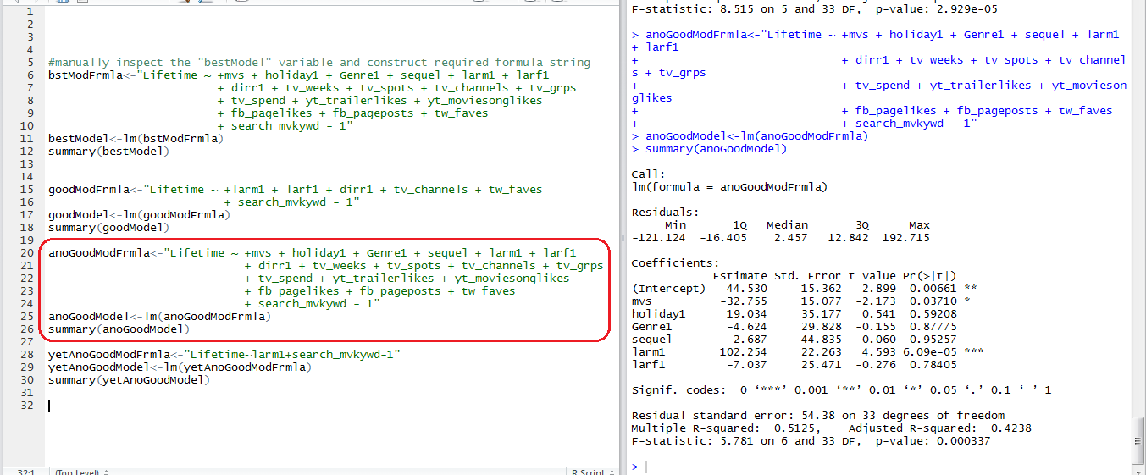
Appendix

Slide 12
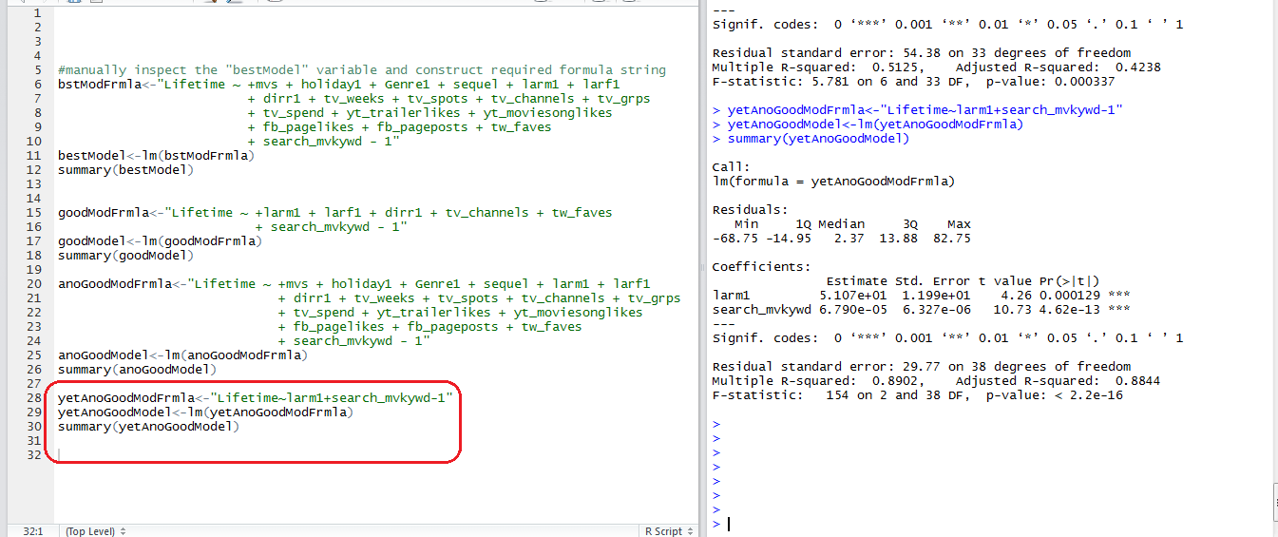
Appendix

Slide 13
Appendix

Slide 14
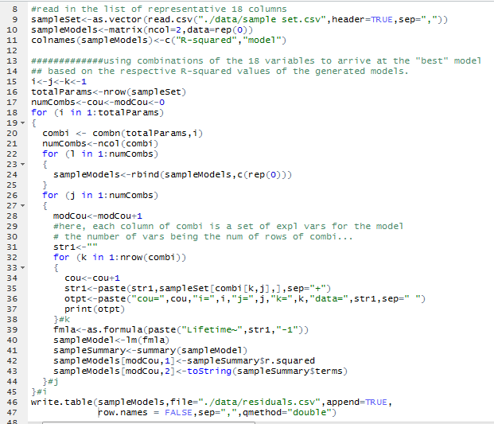
Appendix
The accompanying code snippet illustrates an exhaustive creation and inspection of the models using eighteen explanatory variables.
The combn function is used to determine all combinations of the eighteen variables taken one, two, … , eighteen at a time.

Slide 15
Thank you!

